Slide 1
使用Microsoft Power BI探索和可視化數據
謝坤達]
[ jumbokh@gmail.com ]

Slide 2
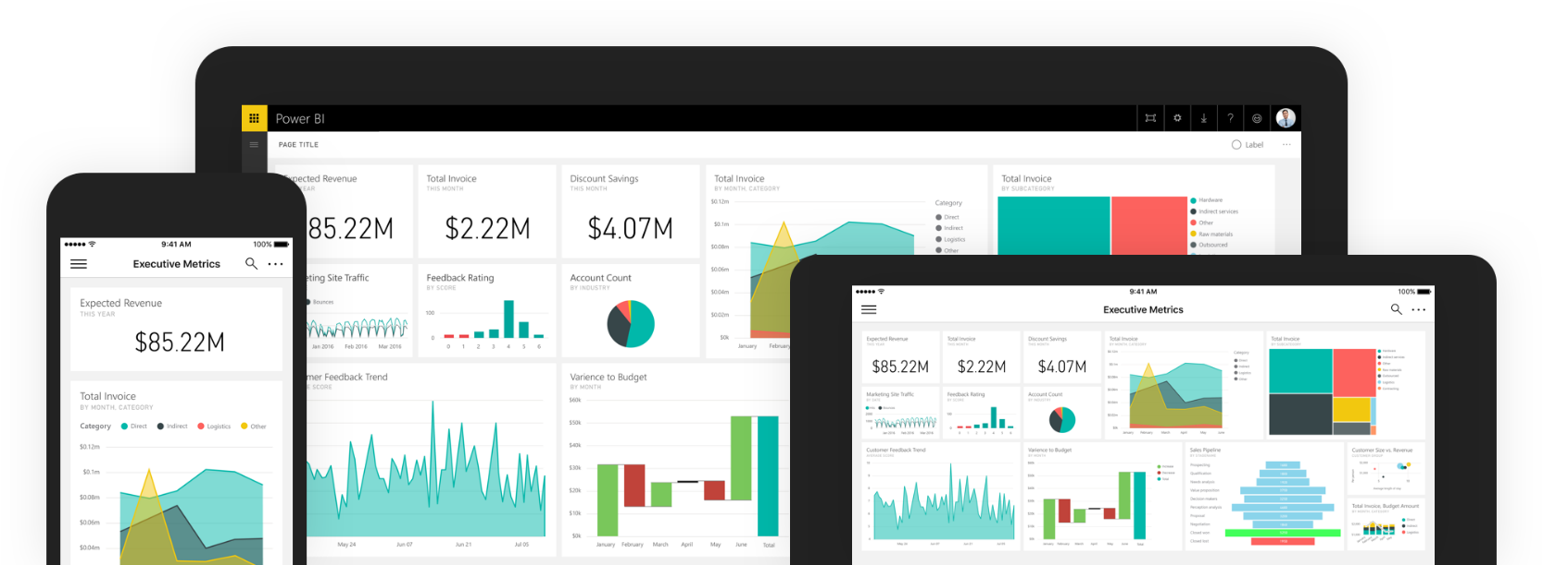
Power BI
Power BI是一套用於分析數據和共享見解的業務分析工具，該工具使業務用戶可以在所有設備和平台上的單個位置訪問其最重要的指標。
Notes:
Power BI can unify all of your organization’s data, whether in the cloud or on-premises. Using the Power BI gateways, you can connect SQL Server databases, Analysis Services models, and many other data sources to your same dashboards in Power BI. If you already have reporting portals or applications, you can embed Power BI reports and dashboards into web and app scenarios for a unified experience across any device or platform.

Slide 3
工具與平台
服務
桌面
移動
嵌入
Web-based
All platforms
Limited design tools
Limited data sources
Dashboards
Publishing
Windows only
Robust design tools
Query and modeling tools
Cross-platform
Report viewers
Report integration
REST services
Create custom visualizations
Notes:
Power BI is a high-level name for Microsoft’s Power BI Services and Tools Suite. In general, all tools draw on the underlying foundation of Power BI Services, which is exposed to users via a web-based design and administration experience. More powerful features are available in the Power BI Desktop application targeting the Windows platform, and mobile versions of Power PI exist for Windows Mobile, iOS, and Android devices that enable end users to interactively access and navigate report and dashboard information. Developer and administrators can also exposed the services of Power BI via Power BI embedded which includes a robust REST-based API as well as tools to create custom visualizations.

Slide 4
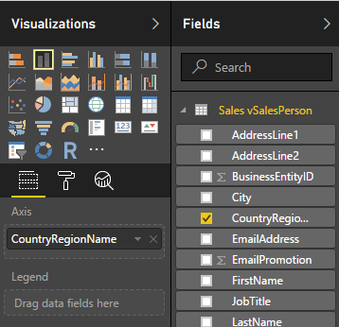
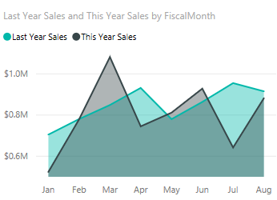
Power BI構建模組
可視化
數據集
報表
儀錶板
圖塊
Notes:
Power BI is a set of services and tools that serve as building blocks for creating powerful Business Intelligence experiences. The primary elements of the Power BI design experience are Visualizations, Datasets (or connections to data stores and services), Reports, Dashboards, and Tiles. The elements are combined into an experience that gets published and shared to users in your organization.

Slide 5
建構區塊關聯
REPORTS
DATA SOURCES
DASHBOARDS
DEVICES
+
VISUALIZATIONS
Notes:
The basic building block for all Business Intelligence elements in Power BI begins with the data itself. Data from various sources is filtered, cleaned, and combined into Reports via Visualizations, and optionally published to Dashboards. Dashboard data is surfaced to users on any device, based on permissions and organization needs.

Slide 6
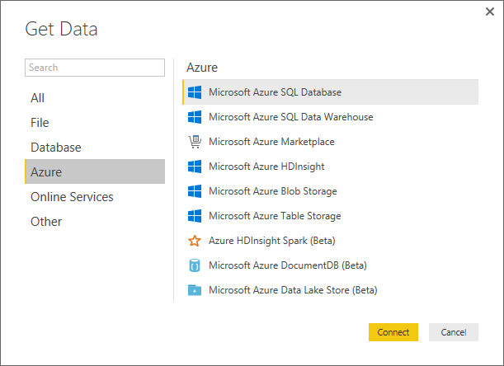
獲取數據
Power BI可以連接到各種數據源，包括本地數據庫，Azure存儲，Excel工作表和大量的第三方服務。
使用查詢編輯器清理和轉換數據
連接到高級數據源並創建轉換
“拿捏”格式不規則的數據
Notes:
A primary goal of Microsoft Power BI is to enable report creators, managers, and stakeholders to connect to any data source necessary to create a unified experience that makes sense to audiences and viewers of the content. Along with full support for more typical, legacy systems such as an Excel spreadsheet or SQL Server database, Power BI can authenticate and access data across a wide variety of data sources via “Connectors”, including Azure, Oracle, or even external services such as Facebook, Salesforce, or MailChimp,

Slide 7
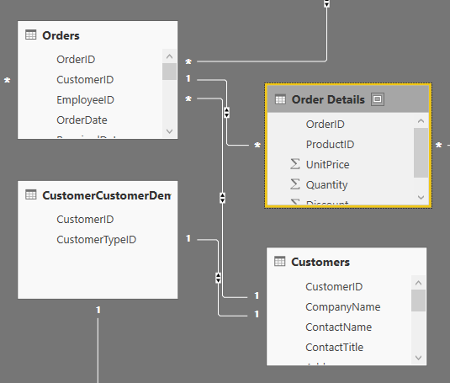
建模
建模是在數據源之間創建邏輯連接和關係的技術。
創建計算列
優化數據模型以獲得更好的視覺效果
創建度量並使用基於時間的功能
創建計算表
Notes:
Creating logical connection between different data sources leverages the concept of relationships. A relationship enables Power BI to comprehend how tables and data structures relate to each another to ultimately design and create compelling visuals and reports. The processes of managing and adjusting these relationships across data sources is referred to as modeling, and uses the concepts of Measures, Calculated Columns, and even Calculated Tables (similar to the old fashioned notion of views.)

Slide 8
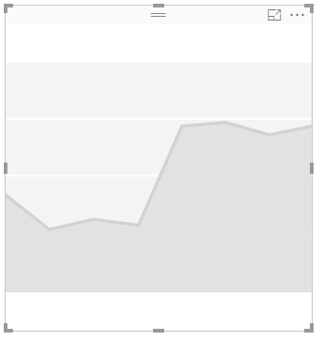
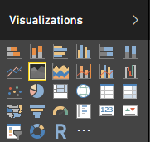
可視化
可視化是數據的可視表示，例如圖表，圖形，地圖或其他“可視”數據表示。
Line, bar, pie, stacked
Matrix/pivots
Key performance
Tree maps
Geo and filled maps
Slicers/filters
Custom visualizations
Notes:
Visualizations or “Visuals” are the end-result of any Business Intelligence effort. Ultimately, the aim is to access data, any data that makes sense in our organization, and present it to users in a meaningful, compelling, interactive, and insightful way. Power BI exposes a large number of out-of-the-box visualizations found in common Business Intelligence tools, such as numerous graphs, charts, maps, and filters, while also enabling visualization “extensibility” for creating organization-specific or scenario-specific custom visuals to be created by developers and power users.

Slide 9
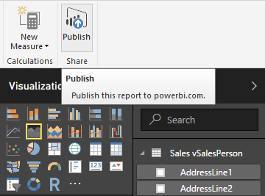
發佈與分享
將報表從Power BI 桌面版發佈到Power BI服務
列印和匯出儀表板
手動重新發佈和刷新數據
創建並連接到內容包
為商業應用整合OneDrive
Notes:
Power BI content, typically in the form of Reports and Dashboards, can be shared and published (securely if necessary) for viewing over the web as well as printing and exporting reports to numerous supported formats. Entire Power BI experiences, along with the essential dependences (like Dashboards, associated Reports, and the underlying Datasets) can easily be packaged into Power BI “Content Packs” for distribution in an organization. Content Packs are then available to the appropriate users within their Power BI experience automatically. OneDrive for Business can be used as well as the source for you content as well, making it easy to leverage built in permission and security trimming, as well as more document-centric features such as versioning.

Slide 10
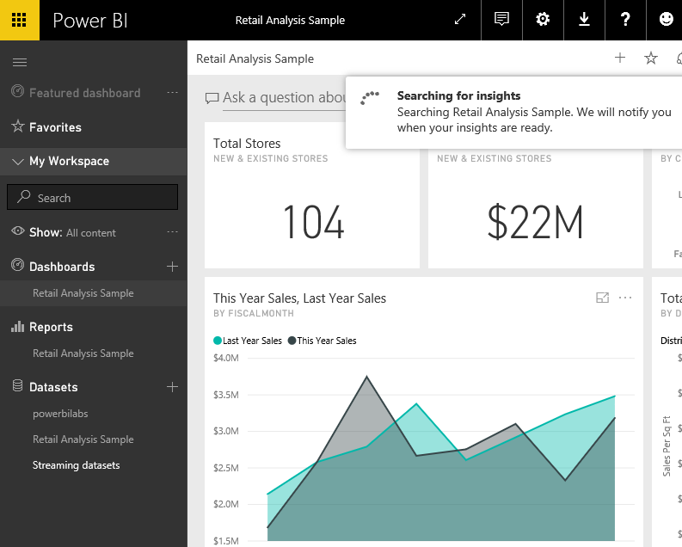
探索數據
使用快速見解
用自然語言提問
創建自定義的問答建議
與您的組織共享儀表板
編輯圖塊詳細信息
Notes:
Built into the Power BI experience is the ability for users to glean additional information “on-the-fly” via a natural language question and answer paradigm, as well as providing quick “insights” into a dashboard, report, or the associated data based on intelligent analysis of current datasets. Power BI makes it easy to access these features by keeping the front and center during the user experience.

Slide 11
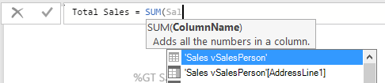
數據分析表達式
DAX是函數，運算符和常量的集合，可在公式或表達式中使用它們來計算和返回一個或多個值。
聚合後對行集合的度量計算。
聚合之前，對每個單獨的行進行計算列計算。
Notes:
Data Analysis Expressions, or “DAX” includes a library of over 200 functions, operators, and constructs and are similar to Excel formulas. DAX has many of the same functions as Excel, except that DAX functions are meant to work over data interactively “sliced” or filtered in a report. If users are familiar with writing Excel functions, its an easy transition into DAX.

Slide 12
Power BI服務整合
通過Power BI 嵌入可以促進Power BI服務整合。 Power BI 嵌入是一項Azure服務，使開發人員能夠在其應用程序中展現Power BI數據體驗。
DEVELOPER
AZURE
SUBSCRIPTION
AZURE
DATA
WORKSPACES
WORKSPACE
APP
APP
Notes:
As an optional Azure Service, Power BI Embedded is the mechanism used by app developers to surface Power BI data and data experiences in their applications. Although Power BI Embedded is a paid service, end-users don’t need Power BI accounts to use services or applications exposed via Power BI Embedded. Power BI Embedded is quickly become the primary Business Intelligence integration mechanism for developers previously creating solutions with older tools and technologies such as SQL Server Reporting Services.

Slide 13
Hands-On Lab
Power BI HOL.html

